Slide 1
Build a simple static website using Flask and Bootstrap
Section 11
Notes:
[Mandatory Slide] This would be the introduction slide of the topic that you are covering in this section.
When this slide plays, you could talk about the main aim that we’d be covering in this section.

Slide 2
What We’ll Learn
Starting up the project
Coding the Flask views
Testing the website
Preparing the static pages
Creating a protected area and handling user authentication with a credential form
Install Flask and Bootstrap and layout the project’s folder
Code the request handlers and URL routes
Strategies for testing both sides of the web application
Create a minimal HTML template hierarchy
Implement a user authentication form backed by an authentication mechanism

Slide 3
Starting up the project
Notes:
[Mandatory Slide] This would be the introduction slide of the topic that you are covering in this subsection.
When this slide plays, you could talk about the main aim that we’d be covering in this video.

Slide 4
In this Video, we are going to take a look at…
A static website project
Setting up Flask
What is Bootstrap?
Setting up Bootstrap
Laying out the project structure
Notes:
[Mandatory Slide]
Before the start of the video, we’d like to highlight what are important topics or pointers that we’d be covering in this video. This slide would immediately follow the intro/name slide. This would just be say 2-3 points for the viewers to know what they are getting into.

Slide 5
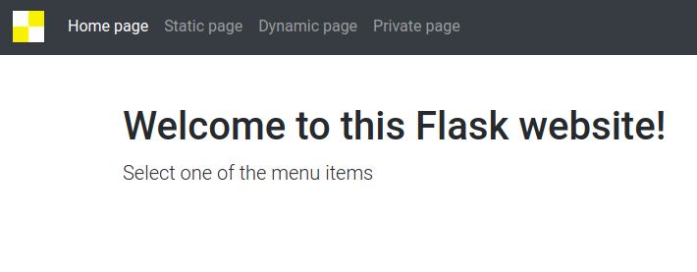
A static website project
Let’s create a website using Flask! A static one, but not 100%...
DYNAMIC PAGE
(eg. containing server timestamps)
STATIC PAGE
STATIC HOME PAGE
PRIVATE STATIC PAGE
(only accessible via authentication through a login form)
NAVBAR
and FOOTER
Notes:
[Mandatory Slide]
Before the start of the video, we’d like to highlight what are important topics or pointers that we’d be covering in this video. This slide would immediately follow the intro/name slide. This would just be say 2-3 points for the viewers to know what they are getting into.

Slide 6
Setting up Flask
Really nothing more than: pip install Flask
Notes:
[Mandatory Slide]
Before the start of the video, we’d like to highlight what are important topics or pointers that we’d be covering in this video. This slide would immediately follow the intro/name slide. This would just be say 2-3 points for the viewers to know what they are getting into.

Slide 7

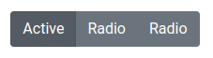
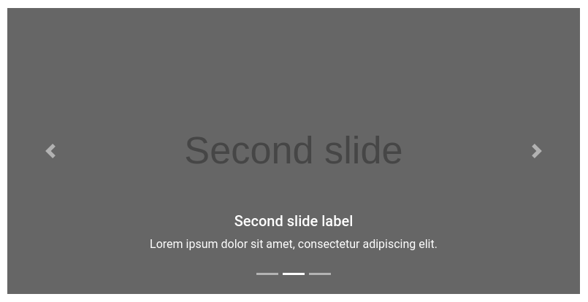
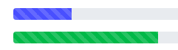
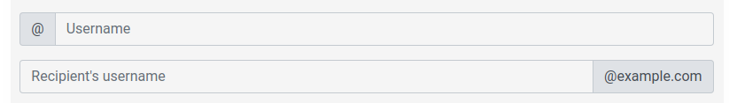
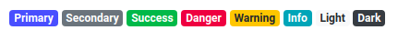
What is Bootstrap?
Bootstrap is an HTML+CSS+Javascript library that can be used to quickly create web sites or the client sides of web applications, with out-of-the-box cross-device support
Boostrap provides common “graphical components” (buttons, carousels, drop downs, menu headers, footers, ...) along their customizable CSS styles and the Javascript code to transition their graphical state whenever they animate
We’ll rework some examples from the Bootstrap 4 website as foundations for our Flask templates:
Sticky Footer Navbar (https://getbootstrap.com/docs/4.0/examples/sticky-footer-navbar/)
Signin Form (https://getbootstrap.com/docs/4.0/examples/sign-in/)
Notes:
[Mandatory Slide]
Before the start of the video, we’d like to highlight what are important topics or pointers that we’d be covering in this video. This slide would immediately follow the intro/name slide. This would just be say 2-3 points for the viewers to know what they are getting into.

Slide 8
Setting up Bootstrap
Save the HTML page of the Sticky Footer Navbar example and rework it so it becomes our base template
Save the HTML page of the Signin Form template and rework it so it becomes the login page template
As any CSS and JS files, Bootstrap’s stylesheets and Javascript files can either be loaded from a Content-Delivery Network (CDN) or be saved locally and then served by your webserver. We’ll go for the second approach:
Save all the CSS files referenced by the base template to a specific folder
Same for all the JS files but to a different folder
In the base template, patch all of the URL reference links for JS and CSS files so that they point the correct local folders
Notes:
[Mandatory Slide]
Before the start of the video, we’d like to highlight what are important topics or pointers that we’d be covering in this video. This slide would immediately follow the intro/name slide. This would just be say 2-3 points for the viewers to know what they are getting into.

Slide 9
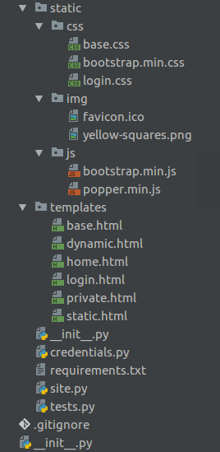
Laying out the project structure
Static Resources
Styles
Images
JS
HTML Templates
Static/Dynamic
Logic
Controllers
Tests
Notes:
[Mandatory Slide]
Before the start of the video, we’d like to highlight what are important topics or pointers that we’d be covering in this video. This slide would immediately follow the intro/name slide. This would just be say 2-3 points for the viewers to know what they are getting into.

Slide 10
Summary
A static website project
Setting up Flask
What is Bootstrap?
Setting up Bootstrap
Laying out the project structure
Notes:
[Mandatory Slide]
Before the start of the video, we’d like to highlight what are important topics or pointers that we’d be covering in this video. This slide would immediately follow the intro/name slide. This would just be say 2-3 points for the viewers to know what they are getting into.

Slide 11
Preparing the static pages
Next Video
Notes:
[Mandatory Slide]
Here the name of the next video needs to be mentioned. The narration as you guessed it would be just letting the viewer know exactly where we are at and what we’d be taking over next! ☺

